Slide 1
SQL Constraints, Functions & Views
Session 3
Shailendra Kumar Saini, Taru Sharma

Slide 2
Objective
Constraints
Primary
Not Null
Default
Unique
Check
Foreign
Functions
Scalar
Aggregate
Operators
Comparison
Arithmetic
Logical
Views

Slide 3
Constraints
Constraints are used to specify the rules for the data in a table.
Used to limit the type of data that can go into a table.
If there is any violation of constraint while inserting or updating the data, that operation is aborted.
Ensures the accuracy and reliability of data in the database.
Constraints are specified when a table is created with the CREATE TABLE statement.
We can use ALTER TABLE statement also to create new constraints for already created table and drop already created constraints.
https://www.geeksforgeeks.org/sql-constraints/

Slide 4
Constraints
Constraints could be column level or table level. Column level constraints are applied only to one column, whereas table level constraints are applied to the whole table.
CREATE TABLE [table name](
[column name1] [data type]([size]) [column constraint],
[column name2] [data type]([size]) [column constraint],
[table constraint] ([[column name]……])……);

Slide 5
Constraints: Primary Key
Primary key is a field in a table which uniquely identifies each row in a database table.
Primary keys must contain unique values.
A primary key column cannot have NULL values.
A table can have only one primary key, which may consist of single or multiple fields. When multiple fields are used as a primary key, they are called a composite key.
If a table has a primary key defined on any field(s), then you can not have two records having the same value of that field(s).

Slide 6
Constraints: Primary Key
CREATE TABLE User(
UserId INT,
Name VARCHAR(100),
Email VARCHAR(100),
Password VARCHAR(15),
DateOfBirth DATE,
PRIMARY KEY(UserId)
);
UserId as a Primary Key.
CREATE TABLE User(
UserId INT,
Name VARCHAR(100),
Email VARCHAR(100),
Password VARCHAR(15),
DateOfBirth DATE,
PRIMARY KEY(UserId, Email)
);
Combination of UserId and Email is Primary Key.

Slide 7
Constraints: Primary Key
Adding Primary Key to existing table:
ALTER TABLE User
ADD PRIMARY KEY (UserId);
Removing primary key from a table:
ALTER TABLE User
DROP PRIMARY KEY;

Slide 8
Constraints: NOT NULL
Ensures that a column cannot have NULL value.
By default, a column can hold NULL values. If you do not want a column to have a NULL value, then you need to define NOT NULL constraint on that column specifying that NULL is not allowed for that column.
A NULL is not the same as no data, rather, it represents unknown data.

Slide 9
Constraints: NOT NULL
CREATE TABLE User(
UserId INT,
Name VARCHAR(100),
Email VARCHAR(100) NOT NULL,
Password VARCHAR(15),
DateOfBirth DATE,
PRIMARY KEY(UserId)
);
Adding NOT NULL constraint to existing table:
ALTER TABLE User
MODIFY NAME VARCHAR(100) NOT NULL;

Slide 10
Constraints: DEFAULT
The DEFAULT constraint provides a default value to a column when the INSERT INTO statement does not provide a specific value.
CREATE TABLE User(
UserId INT,
Name VARCHAR(100) NOT NULL,
Email VARCHAR(100) NOT NULL,
Country VARCHAR(100) DEFAULT ‘INDIA’
Password VARCHAR(15),
PRIMARY KEY(UserId)
);

Slide 11
Constraints: UNIQUE
The UNIQUE Constraint prevents two records from having same values in a particular column.
CREATE TABLE User(
UserId INT,
Name VARCHAR(100) NOT NULL,
Email VARCHAR(100) NOT NULL UNIQUE,
Password VARCHAR(15),
PRIMARY KEY(UserId)
);

Slide 12
Constraints: CHECK
The CHECK Constraint enables a condition to check the value being entered into a record. If the condition evaluates to false, the record violates the constraint and isn't entered into the table
CREATE TABLE User(
UserId INT,
Name VARCHAR(100) NOT NULL,
Email VARCHAR(100) NOT NULL UNIQUE,
GENDER CHAR(1) CHECK (Gender IN ('M','F')),
PRIMARY KEY(UserId)
);
Note: MySQL 8.0.16 is the first version that supports CHECK constraints.

Slide 13
Constraints: FOREIGN Key
A foreign key is a column or combination of columns which can be used to set a link between the data in two tables.
PRIMARY KEY of a table is linked to the FOREIGN KEY of another table to enhance data integrity.
With a relational DBMS, the relationship between rows in two tables is expressed by a foreign key in the dependent table. A foreign key is one or more columns that contain a value identical to a primary key (or unique key) value in some row in the parent table (i.e., the referenced table).

Slide 14
Constraints: FOREIGN Key
Consider 2 tables Customer and Order. Order table is having the records of orders placed by Customer. Since Order can be placed by only valid customer. We can have this constraint for CustomerId column in Order table that points to CustomerId in Customer Table. This make sures that Order table will not have any invalid CustomerId.
Customer(CustomerId, Name, Email, Address);
Order (OrderId, Date, CustomerId, Amount);
FOREIGN KEY (CustomerId) REFERENCES Customer(CustomerId)

Slide 15
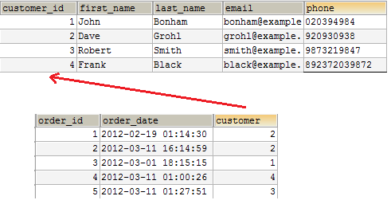
Constraints: FOREIGN Key

Slide 16
Constraints: FOREIGN Key
CREATE TABLE User(
UserId INT,
Name VARCHAR(100),
Email VARCHAR(100),
Password VARCHAR(15),
PRIMARY KEY(UserId)
);
CREATE TABLE Order(
OrderId INT,
CreatedDate DATE,
UserId INT,
Amount decimal(8,2),
PRIMARY KEY(OrderId),
FOREIGN KEY (UserId) REFERENCES User(UserId)
);

Slide 17
Functions
MySQL has rich library of in built in functions & operators working on various data types like string, numeric, date and other advanced processing.
Scalar functions: return a single value, based on the input value.
Aggregate functions: are used to operates on data sets of a column of a table(return a single value, calculated from values in a column)
https://dev.mysql.com/doc/refman/8.0/en/functions.html
https://www.w3schools.com/sql/sql_ref_mysql.asp
https://w3resource.com/mysql/mysql-functions-and-operators.php

Slide 18
Scalar function examples
LENGTH | Returns the length of the specified string
LOWER | Converts a string to lower-case
UPPER | Converts a string to upper-case
CONCAT | Concatenates two or more expressions together
SUBSTR | Extracts a substring from a string
TRIM | Removes leading and trailing spaces from a string
INSTR | Returns the position of the first occurrence of a string in another string
REPLACE | Replaces all occurrences of a specified string

Slide 19
Scalar function examples
https://www.w3schools.com/sql/sql_ref_mysql.asp
ABS | Returns the absolute value of a number
ROUND | Returns a number rounded to a certain number of decimal places
SQRT | Returns the square root of a number
POW | Returns m raised to the nth power
MOD | Returns the remainder of n divided by m
RAND | Returns a random number or a random number within a range

Slide 20
Scalar function examples
https://www.w3schools.com/sql/sql_ref_mysql.asp
CURDATE | Returns the current date
DATE | Extracts the date value from a date or datetime expression
DATEDIFF | Returns the difference in days between two date values
DAY | Returns the day portion of a date value
EXTRACT | Extracts parts from a date
TIMESTAMP | Converts an expression to a datetime value and if specified adds an optional time interval to the value

Slide 21
Aggregate Functions
Aggregate functions are built-in SQL functions that operate on groups of rows and return one value for the entire group.
AVG | Returns the average value of an expression
COUNT | Returns the number of records in a select query
MAX | Returns the maximum value of an expression. (Selected Column)
MIN | Returns the minimum value of an expression
SUM | Returns the summed value of an expression
FIRST | The FIRST() function returns the first value of the selected column.

Slide 22
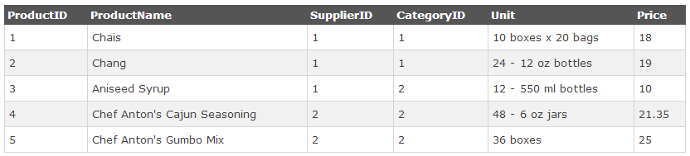
AVG()
SELECT AVG(column_name) FROM table_name
SELECT AVG(Price) AS AveragePrice FROM Products;
SELECT ProductName, Price FROM Products
WHERE Price>(SELECT AVG(Price) FROM Products);

Slide 23
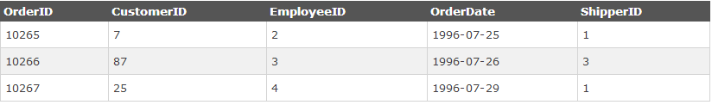
COUNT()
SELECT COUNT(column_name) FROM table_name;
The COUNT(column_name) function returns the number of values (NULL values will not be counted) of the specified column:
SELECT COUNT(*) FROM table_name;
The COUNT(*) function returns the number of records in a table:
SELECT COUNT(OrderID) AS OrdersFromCustomerID7 FROM Orders
WHERE CustomerID=7;

Slide 24
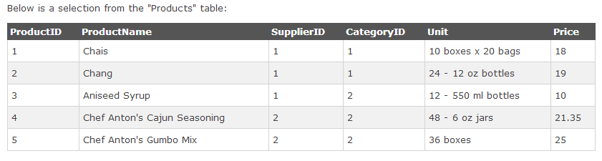
MAX()
The MAX() function returns the largest value of the selected column.
Syntax → SELECT MAX(column_name) FROM table_name;
SELECT MAX(Price) AS HighestPrice FROM Products;

Slide 25
MIN()
The MIN() function returns the smallest value of the selected column.
Syntax → SELECT MIN(column_name) FROM table_name;
SELECT MIN(Price) AS MinimumPrice FROM Products;

Slide 26
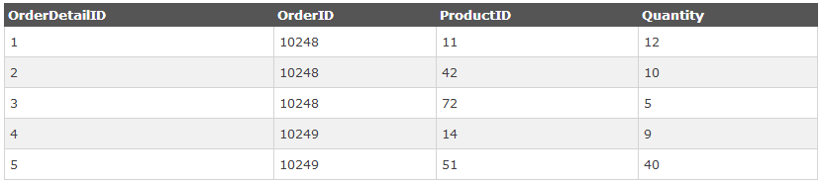
SUM()
The SUM() function returns the total sum of a numeric column.
Syntax → SELECT SUM(column_name) FROM table_name;
SELECT SUM(Quantity) AS TotalItemsOrdered FROM OrderDetails;

Slide 27
Operators
An operator is a reserved word or a character used primarily in an SQL statement’s WHERE clause to perform operation(s), such as comparisons and arithmetic operations.
Comparison operators
Arithmetic operators
Logical operators
https://dev.mysql.com/doc/refman/8.0/en/functions.html
https://www.w3schools.com/sql/sql_ref_mysql.asp
https://w3resource.com/mysql/mysql-functions-and-operators.php

Slide 28
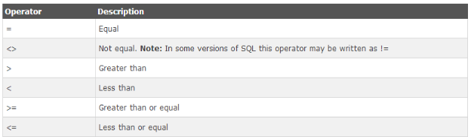
Comparison Operators

Slide 29
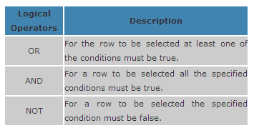
Logical Operators

Slide 30
Logical Operator - IN
The IN operator is used to compare a value to a list of literal values that have been specified.
SELECT * FROM Customers WHERE City IN ('Jaipur', 'Udaipur');
SELECT * FROM Customers WHERE City NOT IN (‘Mumbai’);
The NOT operator reverses the meaning of the logical operator with which it is used. Eg: NOT LIKE, NOT BETWEEN, NOT IN, etc. This is a negate operator.

Slide 31
Logical Operator - Between
These operator selects values within a range. The values can be numbers, text, or dates.
SELECT * FROM Products
WHERE Price
BETWEEN 10 AND 20;
SELECT * FROM Products
WHERE Price
NOT BETWEEN 10 AND 20;

Slide 32
Logical Operator - LIKE
The LIKE operator is used to compare a value to similar values using wildcard operators.
SELECT * FROM Customers WHERE City LIKE 's%'; -- will search for city starting with ‘s’
SELECT * FROM Products
WHERE Title LIKE ‘_en’; -- will search for 3 character title ending with ‘en’ (‘pen’, ‘hen’)

Slide 33
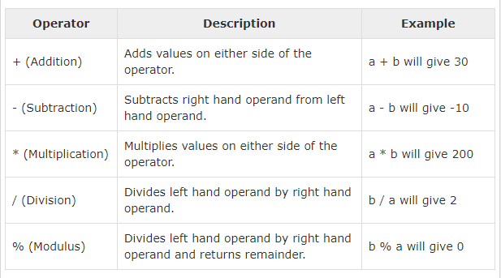
Arithmetic Operators

Slide 34
Views - The Virtual Table
A view can be thought of as a “stored query” or a “virtual table”.
A view is a named SELECT statement that dynamically produces a result set that you can further operate on.
A view doesn't actually store any data.
Takes no space in a database.
https://dev.mysql.com/doc/refman/8.0/en/views.html
https://www.tutorialspoint.com/sql/sql-using-views.htm

Slide 35
Views Advantages
Security :-
To provide an additional level of table security by restricting access to particular rows/columns of a table.
Restricting a user to specific rows in a table
Restricting a user to specific columns
For example, not including price column of books table or not including in a view all those members who belong to category O(Others).

Slide 36
Views Advantages
Simplified Retrievals:-
A view might be defined with a join, which is a collection of related columns or rows in multiple tables.
Joining columns from multiple tables so that they look like a single table.
Aggregating information instead of supplying details.

Slide 37
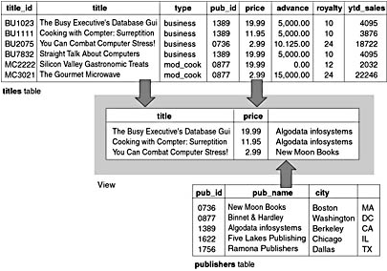
Example
pub_name

Slide 38
Creating a View
In the following example, a CREATE VIEW statement is used to define a SELECT query that returns data from the Northwind database:
CREATE VIEW CustomerOrders
AS
SELECT o.OrderID, c.CompanyName, c.ContactName
FROM Orders o
INNER JOIN Customers c
ON o.CustomerID = c.CustomerID;

Slide 39
Using View
Once a view has been created, you can use the view to access the data that is returned by the SELECT query defined within that view.
SELECT OrderID, OrderDate
FROM CustomerOrders
WHERE CompanyName = 'quick-stop'
ORDER BY OrderID;

Slide 40
Modifying Views
After a view is defined, you can change modify its definition without dropping and recreating the view.
CREATE OR REPLACE VIEW CustomerOrders
AS
SELECT o.OrderID, o.OrderDate, c.CompanyName, c.ContactName
FROM Orders o
INNER JOIN Customers c
ON o.CustomerID = c.CustomerID;

Slide 41
Deleting Views
After a view has been created, you can delete the view if it is not needed.
When a view is deleted, the tables and the data upon which it is based are not affected.
To delete a view, you can use the DROP VIEW statement, as shown in the following example:
DROP VIEW CustomerOrders;

Slide 42
References
http://www.mysqltutorial.org/basic-mysql-tutorial.aspx
https://www.w3schools.com/sql/sql_ref_mysql.asp
https://dev.mysql.com/doc/refman/8.0/en/func-op-summary-ref.html
https://w3resource.com/mysql/mysql-functions-and-operators.php

